Slide 1
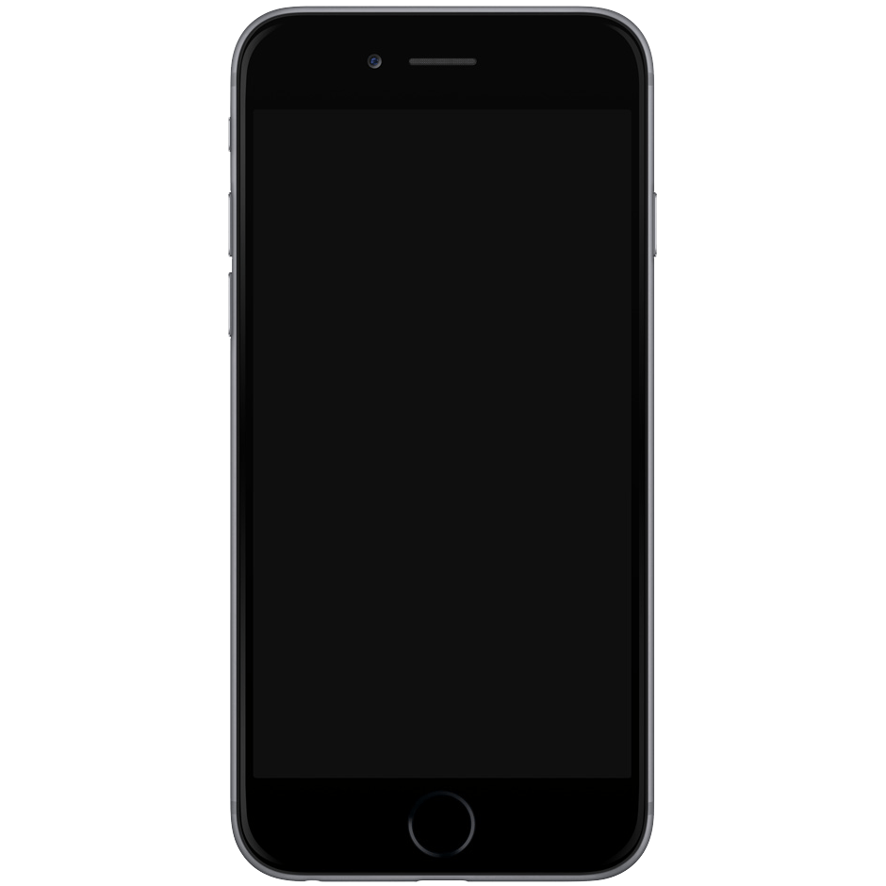
mobile_dev
mobile app-development

Slide 2




Android
iOS

Slide 3




Slide 4





Slide 5



Slide 6
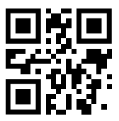


Dart documentation
DartPad
Flutter documentation
dart.dev
dartpad.dev
flutter.dev

Slide 7
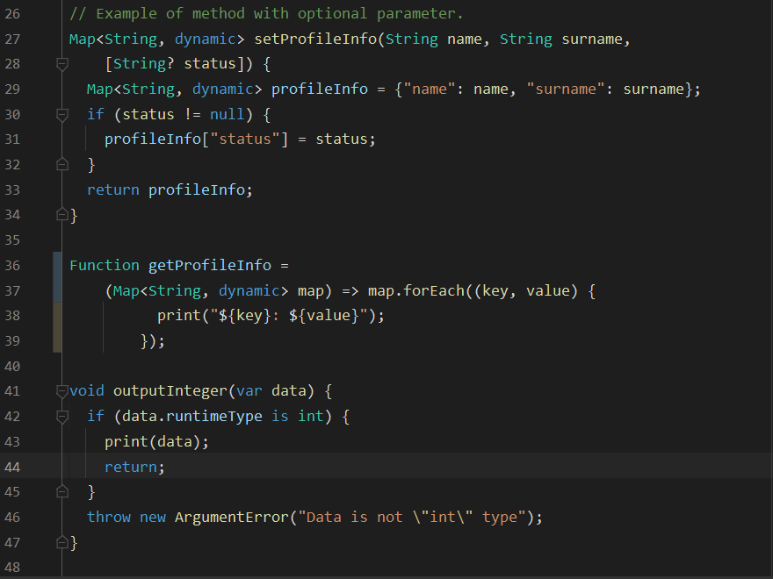
Coding time!

